Slide 1

AAUW Ohio Bylaws Primer 2025
Part 2: Bylaws Are Simple
Nancy Stellhorn

Slide 2
Is Your Branch An AAUW Branch?
Answer: Only if your branch bylaws
  Contain the exact words required for an AAUW branch
  Are sent electronically as a Word document to
    AAUW Association at connect@aauw.org and to
    AAUW Ohio at NSTELL256@gmail.com
  Are received at connect@aauw.org by June 30, 2026

Slide 3

What Is A Bylaw?
A bylaw is a simple, general rule to operate your branch
Every branch member agrees to follow (abide by) the rule(s) of your bylaws

Slide 4
How To Update Your Branch Bylaws
Download a copy of the Affiliate Model Bylaws 2023 found here on AAUW.org on the Bylaws Toolkit page
Click on the “Model Bylaws”

Slide 5
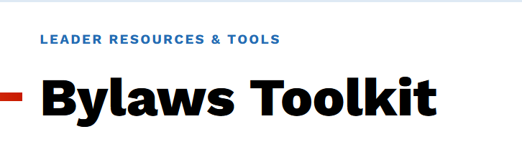
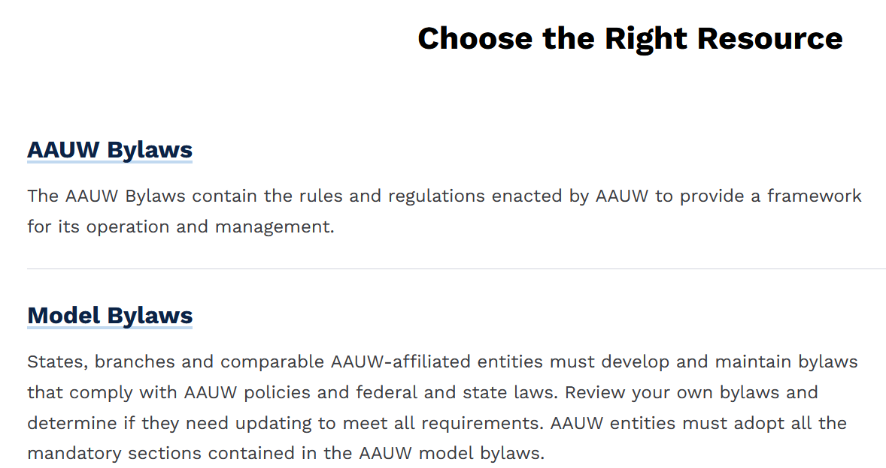

Slide 6
How To Update Your Branch Bylaws
Save a copy of the Model Bylaws to your computer and name it with
  Your branch name and
  The year completed and approved
  For example, Worthington AAUW 2025 Bylaws or Middletown AAUW 2026 Bylaws. (I ask for the area name first so I can find it).
  Your branch is an Affiliate.

Slide 7

Rules for Editing the Affiliate Model Bylaws
You must replace the words “[insert name of Affiliate]” in three places
BYLAWS of THE AMERICAN ASSOCIATION OF
UNIVERSITY WOMEN of [insert naMe of Affiliate]
ARTICLE I. NAME AND GOVERNANCE
Section 1. Name. The name of the organization shall be the American Association of University Women (AAUW) [insert name of Affiliate], hereinafter known as the “Affiliate.”
Section 2. Affiliate. AAUW [insert name of Affiliate] is an Affiliate of AAUW as defined in Article V.

Slide 8
More Rules for Editing the Affiliate Model Bylaws
You must NOT change any anything else in the remaining Affiliate Model Bylaws.
All seven articles must be at the top of your bylaws.
You may add bylaws below the first seven, but none may conflict with the model.

Slide 9
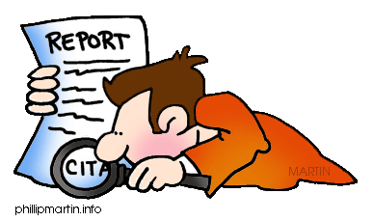
Understanding What the Model Bylaws Say
Your Branch is called an “Affiliate.”
All references to AAUW refer to AAUW National.
References to “Affiliate” are to your branch. For example, AAUW Toledo Branch.
So, bylaws are simple, but they require close reading.

Slide 10
Does My Branch Have To Update Its Bylaws?
Yes, but why?
It is the law. It’s how you continue to be an AAUW branch.
After you insert the 7 Model Bylaws, you may add articles from your old bylaws.

Slide 11

Your Branch Members Must Vote on Bylaws
The Model Branch Bylaws portion does not require a vote.
If you change other parts (Articles after the first 7)
  Your members must vote on other changes.
  You must give them information on the question and time of the vote.

Slide 12
Reasons to Change One of Your Bylaws
  If it conflicts with anything in the first 7 articles
  If it is out of date
  If it explains how to do things and could be part of your Policy
  If the language can be simplified or updated

Slide 13
Do Your Bylaws Have These?
An article about how to amend your bylaws?
  Who can vote?
  How many votes are required for adoption?
  How much notice must be given to members before a vote to change your bylaws?
Responsibilities and tasks of officers?

Slide 14
More Alerts: Other Items to Edit
Reference to branch delegates. Ohio does not have them.
Reference to electronic voting. Ohio Code says that electronic voting is legal if the organization bylaws specify procedures for how it will be done.
Suggestion: At the bottom of the last page, write “Last updated,” mm, dd, yyyy.

Slide 15
Send Updated Branch Bylaws
Electronically to AAUW at connect@aauw.org and
By email as a Word document or PDF to AAUW Ohio at nstell256@gmail.com
Deadline is June 30, 2026. Starz credit for early submission.

